Slide 1



LOAN APPLICATION PROCESSING SYSTEM
IGATE is now a part of Capgemini

Slide 2

TEAM MEMBERS
Raj Subash b -093964_IN
Pavithra Venkatesan -094000_IN
Laveena R -093951_IN
Vinodhini Mohan -093972_IN
Aaqib Ur Rehman -094049_IN
Bandi Dileep -093940_IN
Rohit Hurkadli -094048_IN
Sumit Upadhyay -093983_IN

Slide 3

This project is designed to test an online Loan Application Processing System for bank customers.
This system can be used to apply loan through online.
This system is used by the loan approval department member to approve/ reject any loan applied.
LAD has the responsibility to filter the customers for a specific loan on the basis of application data and interview.
The admin has the responsibility to add new loan plans and manage the existing loans.

Slide 4




Actors
ADMINISTRATOR
Administrator can update and Manage the Loan Programs .Admin has the authority to view all the loan applied in the portal.
ACTORS
LAD
An Actor represents a user or another system that will interact with the system you are modelling.
LAD has the authority to approve or reject loans applied by the customers.
USERS/CUSTOMERS
User can place or apply for the loans in the web portal.

Slide 5
Test Case
A test case is a set of conditions or variables under which a tester will determine whether a system under test satisfies requirements or works correctly.
No. of Test Cases:
No. of Test Cases Passed:
No. of Test Cases Failed:

Slide 6

USE CASES
CUSTOMER USE CASE
LAD FINAL APPROVAL
LAD INTERVIEW
PROJECT ADMINISTRATOR
LAD LOGIN

Slide 7
REQUIREMENTS ITEMIZATION

Slide 8

REQUIREMENTS VALIDATION & FUNCTIONAL DECOMPOSITION
Items in Termination
Items in
Implicit Function
3
Items in Security
22
12
Items in
Error Handling
23
RVFD
8
Items in
File Handling
2
38
4
Items in Invocation
Items in
Explicit Function
Items in System

Slide 9
DFDR
A Defect is an error in coding or logic that causes a program to malfunction or to produce incorrect/unexpected results.
Total no of Defects found :54
No. of Defects found in admin: 20
No. of Defects found in customer: 17
No. of Defects found in LAD: 17

Slide 10
Defects Found…
CUSTOMER
ADMIN
LAD

Slide 11
Application link
http://ndafile:8081/OnlineBankingProjectSpring/

Slide 12
Test Case Adequacy :

Slide 13
Test Case Effectiveness:

Slide 14
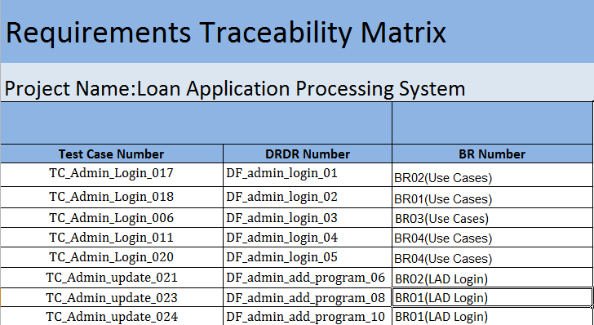
Traceability Matrix

Slide 15
Traceability Matrix
Test Case Number | DRDR Number | BR Number
TC_Admin_Login_017 | DF_admin_login_01 | BR02(Use Cases)
TC_Admin_Login_018 | DF_admin_login_02 | BR01(Use Cases)
TC_Admin_Login_006 | DF_admin_login_03 | BR03(Use Cases)
TC_Admin_Login_011 | DF_admin_login_04 | BR04(Use Cases)
TC_Admin_Login_020 | DF_admin_login_05 | BR04(Use Cases)
TC_Admin_update_021 | DF_admin_add_program_06 | BR02(LAD Login)
TC_Admin_update_023 | DF_admin_add_program_08 | BR01(LAD Login)
TC_Admin_update_024 | DF_admin_add_program_10 | BR01(LAD Login)

Slide 16

QUERIES???

Slide 17

Thank You

